Slide 1

Computer Vision
Perception & Creation
Siyuan Yao

Slide 2
Perception

Slide 3
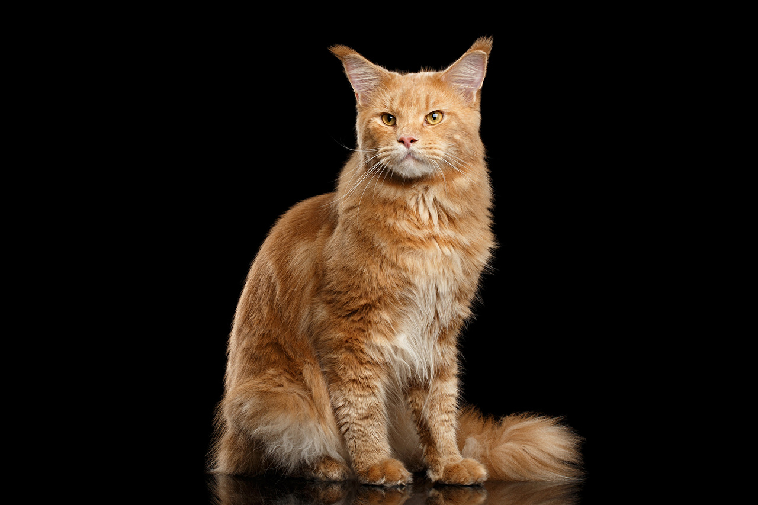

Slide 4
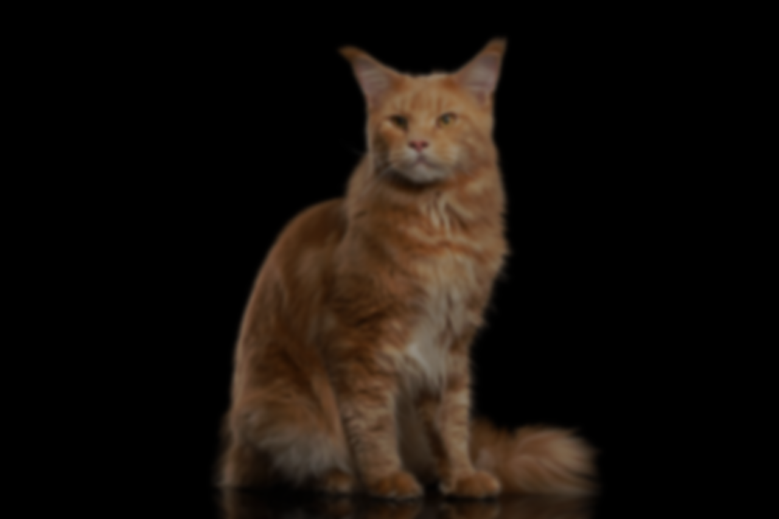

Slide 5

Cat

Slide 6


Slide 7


Slide 9
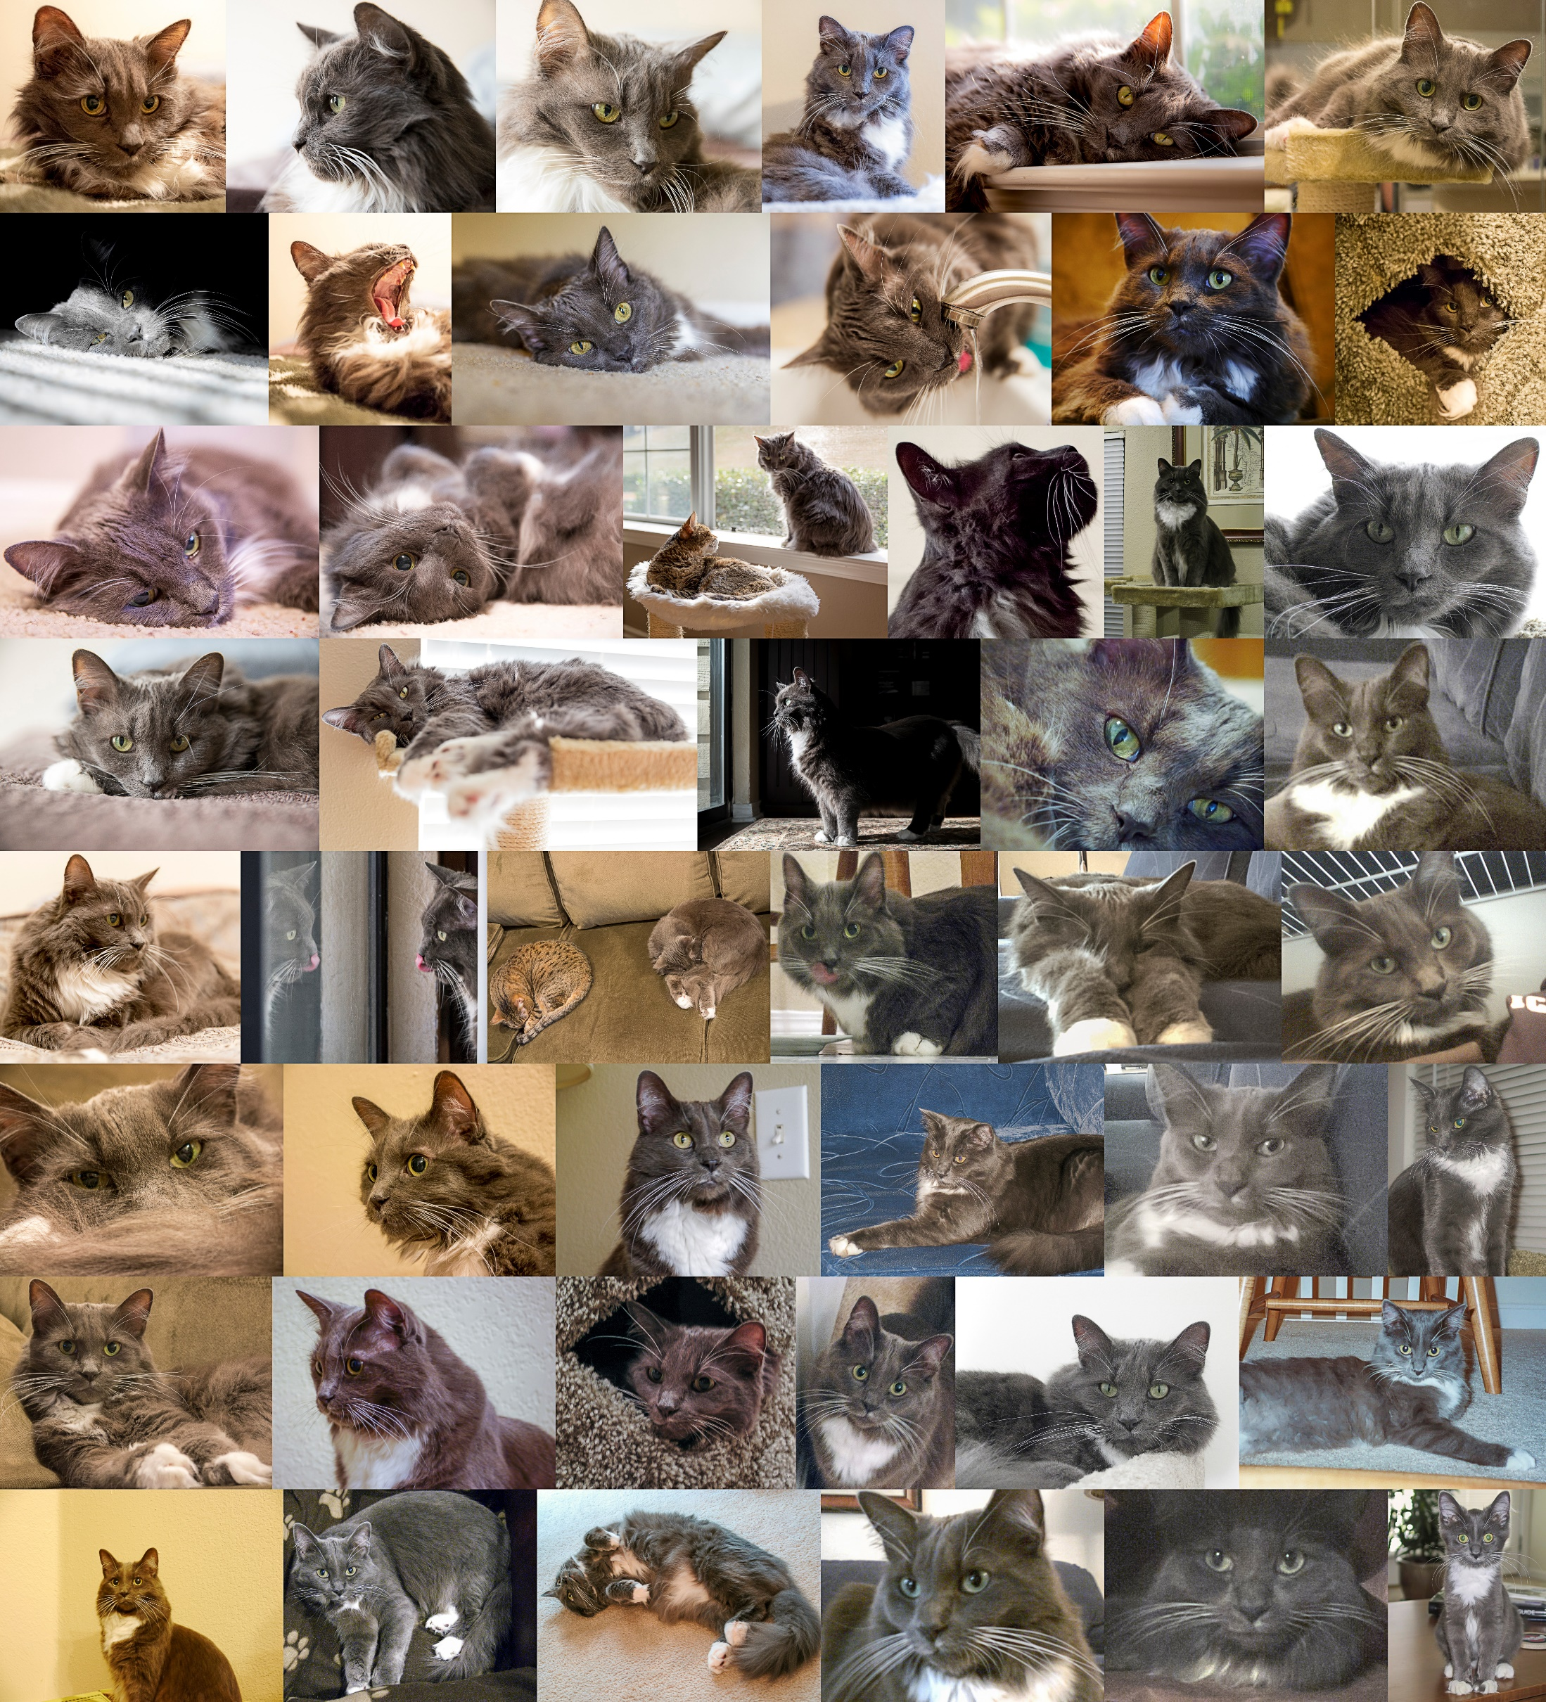
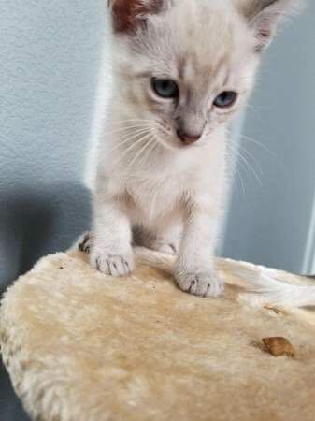
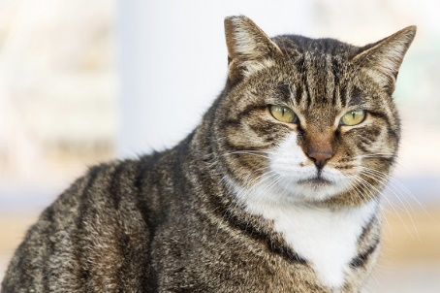
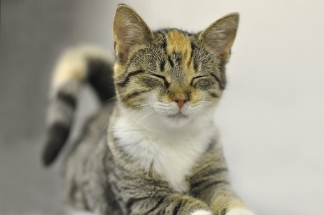
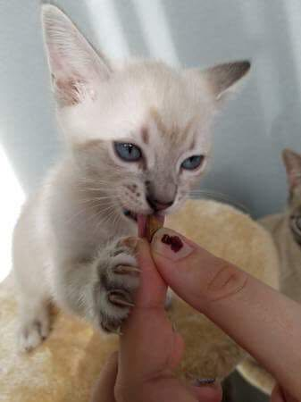
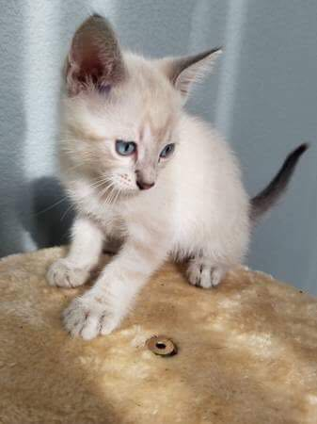
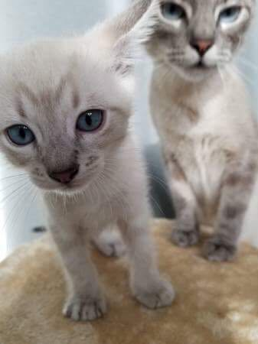

Slide 10


Slide 11


Slide 13
CAT

Slide 14
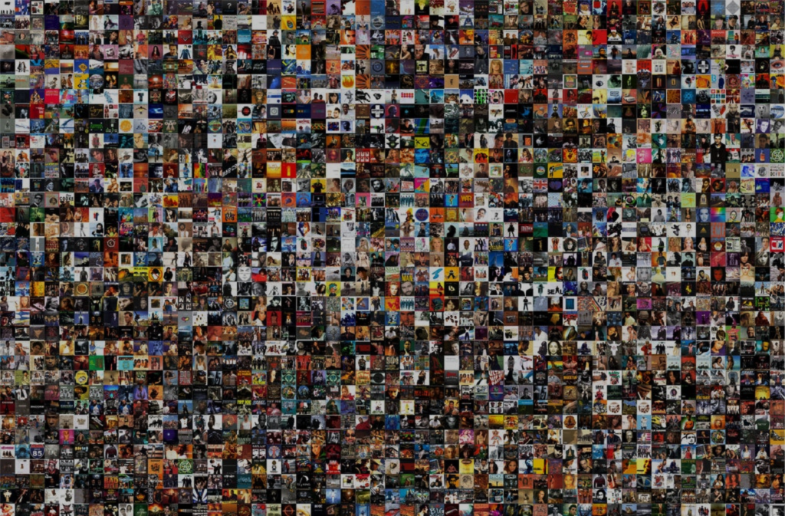

15 million images
22,000 categories

Slide 15
Creation

Slide 16
Knowledge
Perception
Encoding
Creation
Decoding

Slide 17
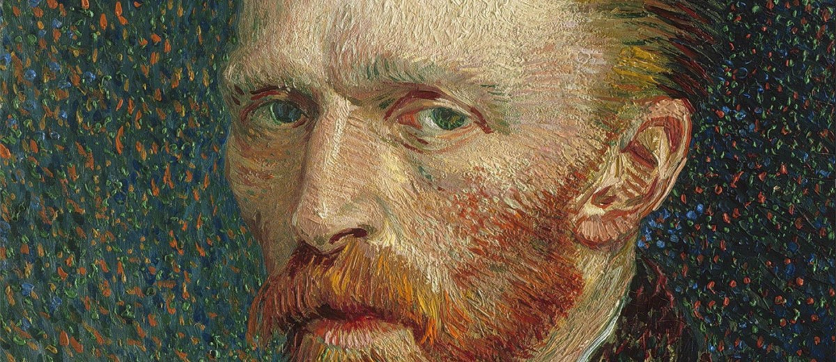

Slide 18
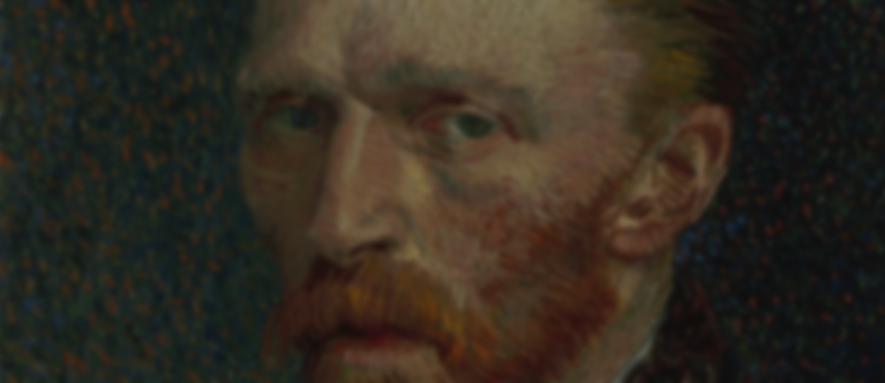
Vincent van Gogh
Confidence: 97%

Slide 19
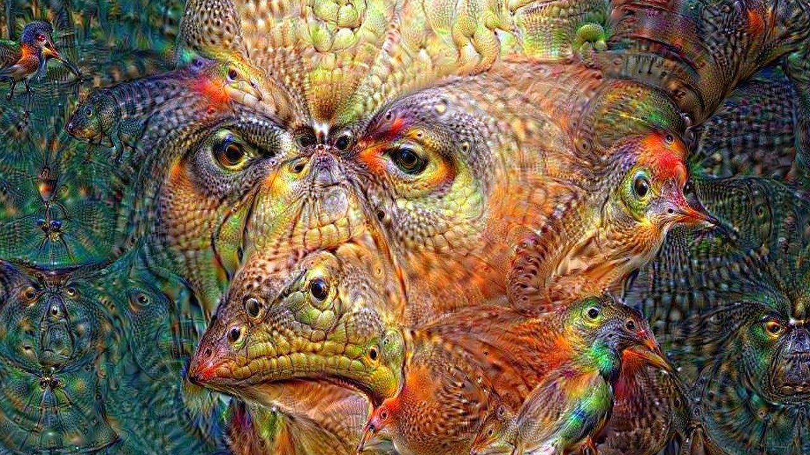

Slide 20
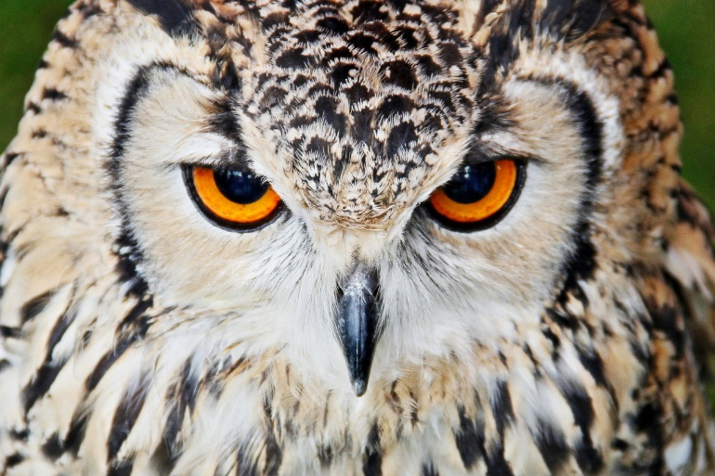

Slide 21
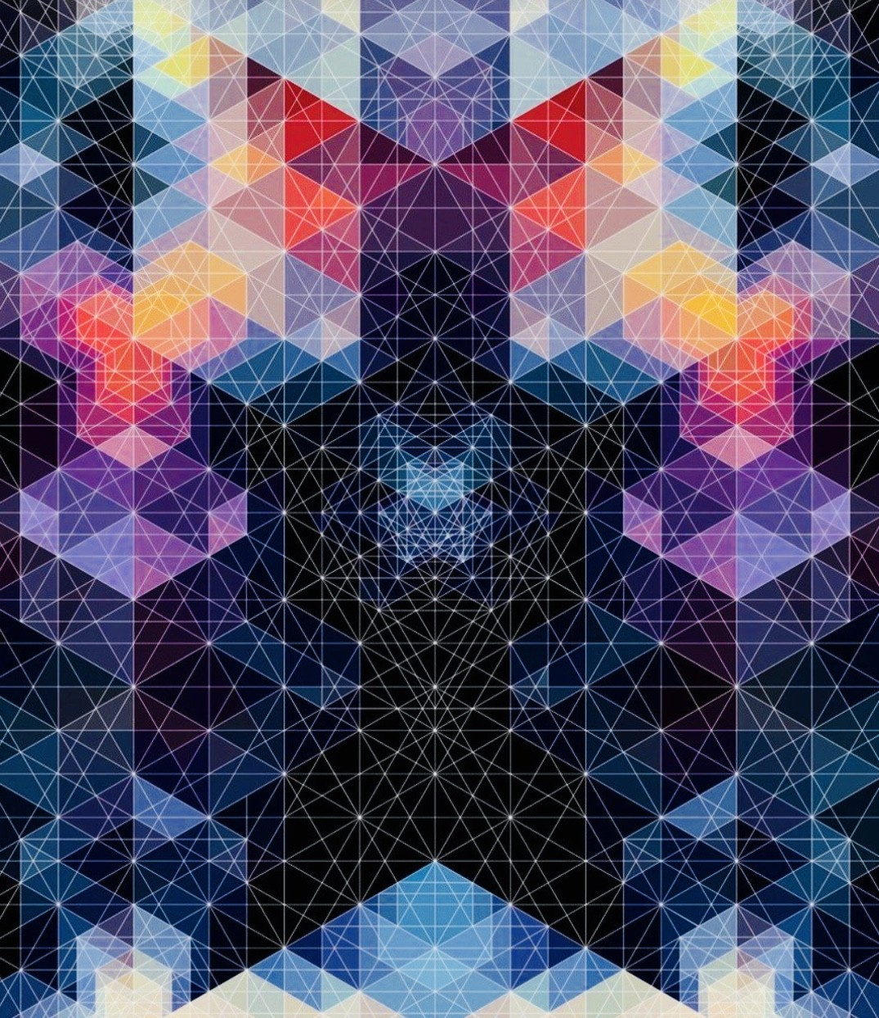

Slide 22
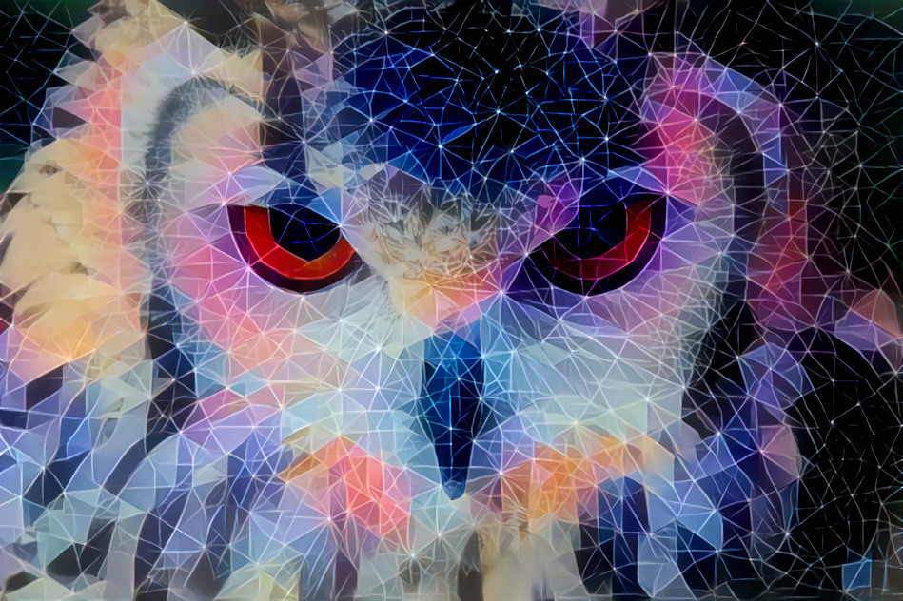

Slide 23
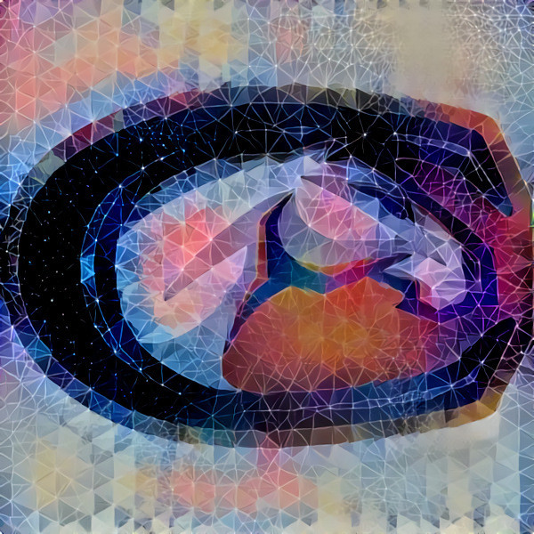

Slide 24
More at
deepdreamgenerator.com

Slide 25
Citations
Images
http://s1.1zoom.me/big0/538/Cats_Maine_Coon_Ginger_498946.jpg
http://www.wallpapers4u.org/wp-content/uploads/cat_black_shadow_dance_jump_1933_1920x1080.jpg
https://plus.google.com/photos/photo/104791564454770703140/6544186903384025586
https://en.wikipedia.org/wiki/Visual_system
https://wagbrag.com/wp-content/uploads/2015/06/4553277701_7d74c5ae92_o.jpg
http://www.matrony.ru/wp-content/uploads/2016/01/vangog-1200x520.jpeg
https://deepdreamgenerator.com/u/415853
Ideas
https://www.ted.com/talks/fei_fei_li_how_we_re_teaching_computers_to_understand_pictures
https://www.ted.com/talks/blaise_aguera_y_arcas_how_computers_are_learning_to_be_creative#t-252015

